Slide 1
A Search App
By Shahmeer Khan
Yahya Tahir
& Talha Ismail

Slide 2
Motivation
The need of having to type whole questions from paper to a Search Engine
Sometimes you don’t have time to type questions
We decided to automate the typing and searching process
Add options to bring up files you wants (ie. Pdfs, Word files etc.)

Slide 3
About the app
Uses Java and is an Android application (Version 6.0+ (API Level 24+))
It’s a bare-minimum app that’s only 647kb (at time of download)
Uses a camera to capture image
OCR (Optical Character Recognition) recognises the text (Using Google’s OpenSource OCR api)
Text is then automatically searched in Google
Options such as “Only PDF’s and Only Word Files” exist making use of Google’s advanced search options

Slide 4
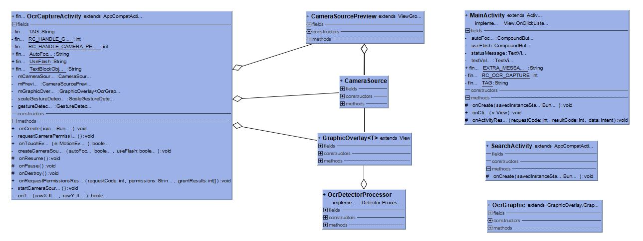
UML

Slide 5
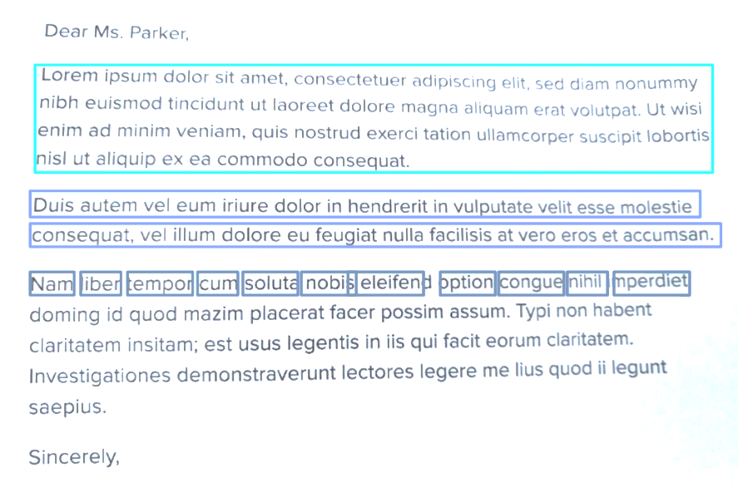
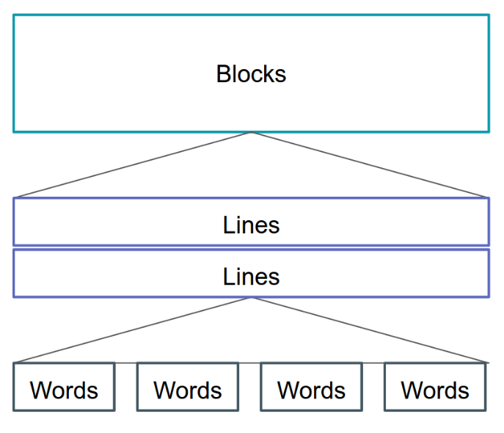
How OC Recognition Works in the App
2 main components
OCR Capture Activity Class – Uses the devices’ camera to capture image and detect
OCR Processor Class – Detects text live
This is added in the OCR Capture Activity
extends Detector <TextBlock>
The OCR algorithm tries to read the text layout and organises each paragraph into TextBlock instances. (Min. one TextBlock is returned)
Text is recognised live, frame by frame, using method detect(Frame frame) in the TextRecogniser class
Frame specifies image data, dimensions, and sequencing information (frame ID, timestamp)
TextRecognizer textRecognizer = new TextRecognizer.Builder(context).build();

Slide 6
How Search works
Using Google’s Search API’s
Using the SearchManager class
Starts new intent for the searching of scanned text
Intent used is
Query passed to ACTION_WEB_SEARCH is in the form SearchManager.QUERY where QUERY contains all the text that’s been recognized in type String
Google Search activity starts
User Specific Queries such as “Only PDF’s “ and “Only DOC’s “ used
Intent intent = new Intent(Intent.ACTION_WEB_SEARCH);

Slide 7
Demo

